Slide 1




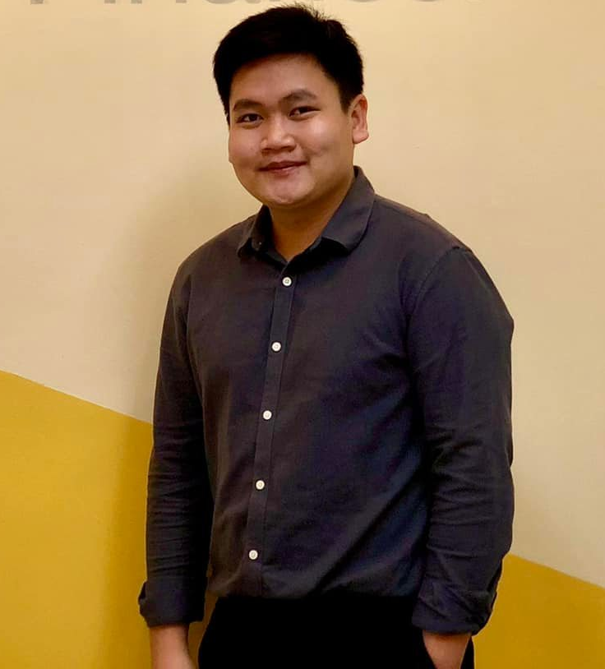
Using Software To Extract The Information About CSR-related Objectives From The Definitive Proxy Statement (SEC Form DEF 14A)
Instructor : Min-Yuh Day, Ph.D.
Artificial Intelligence for Text Analytics – Final report
May 31, 2022
Daniel (Dan Viet Nguyen)
MBA in Finance Program
Key words: CSR, Objectives, Performance

Slide 2
Outline
01.
Introduction
02.
Literature review
03.
Research methodology
04.
Empirical results
05.
Conclusions

Slide 3
Introduction

Slide 4


Introduction
The stakeholder theory
Firms that focus on improving Corporate social performance (CSP) can use Corporate social responsibility (CSR) contracts to create value for all stakeholders (Ikram et al., 2019). Why?
Firm benefits from a better social reputation and economic performance
Corporate governance perspective
Pay for performance has been set as the gold standard for compensation: managers should be paid accordingly to how they perform.

Slide 5
Introduction
Research question:
Whether granting executives CSR-contingent compensation lead to an improvement in Corporate Performance results?
Research impacts and implications
The result will be useful for boards and policymakers in designing CSR-contingent compensation contracts in terms of when to use CSR contracts.
Explain the impact of CSR factors on the performance of companies.
Contributes to the burgeoning literature on the CSR research literature.

Slide 6
Literature review

Slide 7
Literature review
The effect of executive compensation on firm performance
Mehran, H. (1995). Executive compensation structure, ownership, and firm performance. Journal of financial economics, 38(2), 163-184.
Murphy, K. J. (1999). Executive compensation. Handbook of labor economics, 3, 2485-2563.
Tosi, H. L., Misangyi, V. F., Fanelli, A., Waldman, D. A., & Yammarino, F. J. (2004). CEO charisma, compensation, and firm performance. The Leadership Quarterly, 15(3), 405-420.
Basu, S., Hwang, L. S., Mitsudome, T., & Weintrop, J. (2007). Corporate governance, top executive compensation and firm performance in Japan. Pacific-Basin Finance Journal, 15(1), 56-79.
Ozkan, N. (2011). CEO compensation and firm performance: An empirical investigation of UK panel data. European Financial Management, 17(2), 260-285.
Bennett, B., Bettis, J. C., Gopalan, R., & Milbourn, T. (2017). Compensation goals and firm performance. Journal of Financial Economics, 124(2), 307-330.

Slide 8
Literature review
The effect of CSR activities on firm performance
Zairi, M., & Peters, J. (2002). The impact of social responsibility on business performance. Managerial Auditing Journal.
Arendt, S., & Brettel, M. (2010). Understanding the influence of corporate social responsibility on corporate identity, image, and firm performance. Management Decision.
Zhu, Y., Sun, L. Y., & Leung, A. S. (2014). Corporate social responsibility, firm reputation, and firm performance: The role of ethical leadership. Asia Pacific Journal of Management, 31(4), 925-947.
Price, J. M., & Sun, W. (2017). Doing good and doing bad: The impact of corporate social responsibility and irresponsibility on firm performance. Journal of Business Research, 80, 82-97.
Kong, Y., Antwi‐Adjei, A., & Bawuah, J. (2020). A systematic review of the business case for corporate social responsibility and firm performance. Corporate Social Responsibility and Environmental Management, 27(2), 444-454.

Slide 9
Research methodology

Slide 10

Methodology
Methodology
Examine the Proxy Statements filed to U.S. SEC for the fiscal years 1998–2019
In carefully going through these statements, I will note whether any portion of executives' compensation was tied to "safety", "environment", "customer satisfaction", "social responsibility", and/or other variables related to corporate social responsibility
Instead of using manual checking, I will use software (STATA) to detect the keywords.
Source of data:
Incentive Lab data: executive compensation data
Compustat data: firm level data

Slide 11
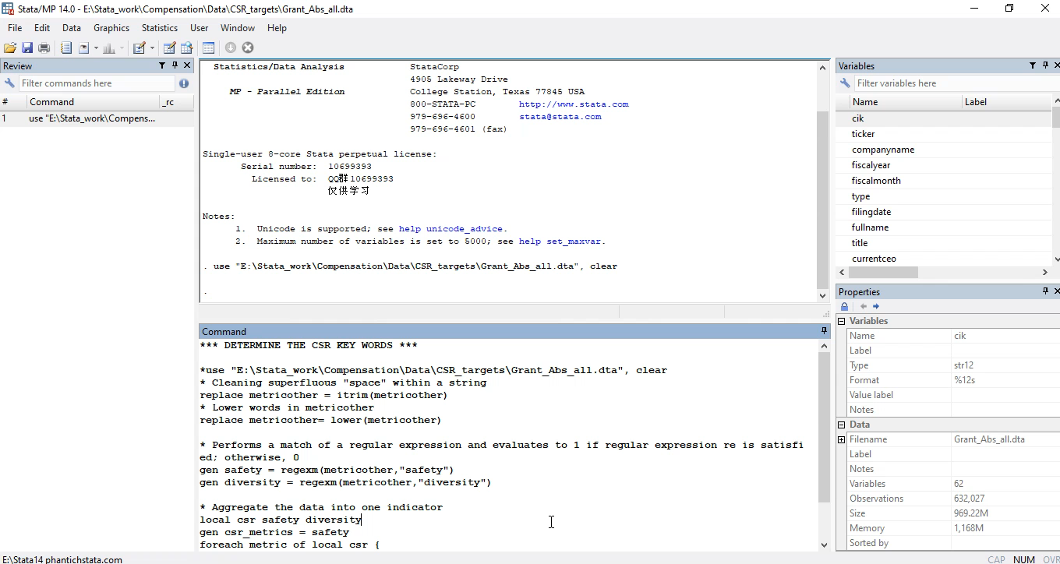
Methodology
https://github.com/dannv248/CSR_detect

Slide 12
Methodology
To evaluate whether granting executives CSR-contingent compensation lead to an improvement in Corporate Performance results, I use the following ordinary least squares (OLS) regression model
performance_{i,t}= $α$+ $β$*csr_metrics_{i,t} + $γ$CEO_power_{i,t} + νFinancial_condition_{i,t} + δ_{t} + $ε$_{i,t}
performance_{i,t} : where i and t are firm and date, respectively
Net profit margin (npm): Operating profit divided by sales
Return on asset (roa): Net income before extraordinary items and discontinued operations divided by total assets
Return on equity (roe): Net income before extraordinary items and discontinued operations divided by total equity
csr_metrics_{i,t} :
A dummy variable = 1 if an executive’s compensation contract has a CSR-related incentive component and 0 otherwise

Slide 13
Methodology
To evaluate whether granting executives CSR-contingent compensation lead to an improvement in Corporate Performance results, I use the following ordinary least squares (OLS) regression model
performance_{i,t}= $α$+ $β$*csr_metrics_{i,t} + $γ$CEO_power_{i,t} + νFinancial_condition_{i,t} + δ_{t} + $ε$_{i,t}
CEO_power_{i,t} :
CEO Duality (chr): A dummy variable = 1 if the firm’s CEO also serves as the chairman of the board
CEO Tenure (tenure): The number of years the executive has been CEO at this firm
CEO Founder (CEO_founder): A dummy variable = 1 if the firm’s CEO also serves as the founder
Financial_condition_{i,t}:
Firm_size (size): The natural logarithm of total asset
Leverage (lev): The book value of firm’s debt
Firm liquidity (liq): The firm current ratio
δ_{t} : is the time fixed effects and control time- invariant observations

Slide 14
Methodology
 | 0 | 1 | Total
1998 | 561 | 20 | 581
1999 | 590 | 7 | 597
2000 | 582 | 14 | 596
2001 | 579 | 14 | 593
2002 | 628 | 9 | 637
2003 | 659 | 12 | 671
2004 | 691 | 24 | 715
2005 | 758 | 23 | 781
2006 | 1,071 | 29 | 1,100
2007 | 1,090 | 37 | 1,127
2008 | 1,083 | 45 | 1,128
2009 | 1,054 | 43 | 1,097
2010 | 1,092 | 47 | 1,139
2011 | 1,077 | 63 | 1,140
2012 | 1,107 | 61 | 1,168
2013 | 1,129 | 55 | 1,184
2014 | 1,171 | 47 | 1,218
2015 | 1,090 | 56 | 1,146
2016 | 1,046 | 77 | 1,123
2017 | 1,070 | 61 | 1,131
2018 | 1,036 | 61 | 1,097
2019 | 947 | 58 | 1,005
Total | 20,111 | 863 | 20,974
csr_metrics_{i,t} :
A dummy variable = 1 if an executive’s compensation contract has a CSR-related incentive component and 0 otherwise

Slide 15
Empirical results

Slide 16
Empirical results
Descriptive Statistics
Variable | Obs | Mean | Std. Dev. | Min | Max
id | 20,974 | 895.123 | 544.645 | 1 | 1974
fyear | 20,974 | 2009.816 | 5.888 | 1998 | 2019
npm | 19,893 | .058 | .173 | -1.786 | .47
roa | 19,854 | .125 | .091 | -.289 | .428
roe | 19,475 | .105 | .202 | -1.275 | 1.143
csr metrics | 20,974 | .041 | .199 | 0 | 1
CEO founder | 16,722 | .082 | .275 | 0 | 1
chr | 16,722 | .545 | .498 | 0 | 1
tenure | 17,155 | 5.918 | 4.401 | 1 | 28
tenure sqr | 17,155 | 54.384 | 82.381 | 1 | 784
size | 20,974 | 8.549 | 1.638 | .383 | 14.986
lev | 20,556 | 3.263 | 3.785 | -16.627 | 28.416
liq | 16,754 | .694 | .385 | .103 | 2.493

Slide 17
Empirical results
 | (1) | (2) | (3)
 | npm | roa | roe
csr_metrics | -0.0161* | -0.0140*** | -0.0232***
 | (0.0087) | (0.0034) | (0.0082)
CEO_founder | 0.0216*** | 0.00848*** | -0.0123**
 | (0.0045) | (0.0029) | (0.0052)
chr | 0.00650** | 0.00148 | 0.0188***
 | (0.0027) | (0.0016) | (0.0038)
tenure | 0.00405*** | 0.00190*** | 0.00626***
 | (0.0009) | (0.0005) | (0.0011)
tenure_sqr | -0.000175*** | -0.0000439* | -0.000223***
 | (0.0000) | (0.0000) | (0.0001)
size | 0.0107*** | -0.00374*** | 0.00180
 | (0.0011) | (0.0007) | (0.0016)
lev | -0.00222*** | -0.00180*** | 0.00980***
 | (0.0005) | (0.0003) | (0.0022)
liq | -0.0222*** | -0.0149*** | -0.0119**
 | (0.0041) | (0.0021) | (0.0051)
cons | -0.0320*** | 0.206*** | 0.0604***
 | (0.0110) | (0.0072) | (0.0153)
R2 | 0.0342 | 0.0382 | 0.0289
N | 13213 | 13125 | 12704

Slide 18
Conclusions

Slide 19
Conclusions
By using the regression model:
Granting executives CSR-contingent compensation has a statistically negative effect on the firm performance measured by profit margin, return on asset, and return on equity
The result will be useful for boards and policymakers in designing CSR-contingent compensation contracts in terms of when to use CSR contracts.
Contributes to the burgeoning literature on the CSR research literature.

Slide 20
References
GitHub:
https://github.com/dannv248/CSR_detect

Slide 21
References
Ikram, A., Li, Z. F., & Minor, D. (2019). CSR-contingent executive compensation contracts. Journal of Banking & Finance, 105655
Maas, K. (2018). Do corporate social performance targets in executive compensation contribute to corporate social performance?. Journal of Business Ethics, 148(3), 573-585.
Li, Z. F., & Thibodeau, C. (2019). CSR-contingent executive compensation incentive and earnings management. Sustainability, 11(12), 3421.
Mehran, H. (1995). Executive compensation structure, ownership, and firm performance. Journal of financial economics, 38(2), 163-184.
Murphy, K. J. (1999). Executive compensation. Handbook of labor economics, 3, 2485-2563.
Tosi, H. L., Misangyi, V. F., Fanelli, A., Waldman, D. A., & Yammarino, F. J. (2004). CEO charisma, compensation, and firm performance. The Leadership Quarterly, 15(3), 405-420.
Basu, S., Hwang, L. S., Mitsudome, T., & Weintrop, J. (2007). Corporate governance, top executive compensation and firm performance in Japan. Pacific-Basin Finance Journal, 15(1), 56-79.
Ozkan, N. (2011). CEO compensation and firm performance: An empirical investigation of UK panel data. European Financial Management, 17(2), 260-285.
Bennett, B., Bettis, J. C., Gopalan, R., & Milbourn, T. (2017). Compensation goals and firm performance. Journal of Financial Economics, 124(2), 307-330.
Zairi, M., & Peters, J. (2002). The impact of social responsibility on business performance. Managerial Auditing Journal.
Arendt, S., & Brettel, M. (2010). Understanding the influence of corporate social responsibility on corporate identity, image, and firm performance. Management Decision.
Zhu, Y., Sun, L. Y., & Leung, A. S. (2014). Corporate social responsibility, firm reputation, and firm performance: The role of ethical leadership. Asia Pacific Journal of Management, 31(4), 925-947.
Price, J. M., & Sun, W. (2017). Doing good and doing bad: The impact of corporate social responsibility and irresponsibility on firm performance. Journal of Business Research, 80, 82-97.
Kong, Y., Antwi‐Adjei, A., & Bawuah, J. (2020). A systematic review of the business case for corporate social responsibility and firm performance. Corporate Social Responsibility and Environmental Management, 27(2), 444-454.

Slide 22
Using Software To Extract The Information About CSR-related Objectives From The Definitive Proxy Statement (SEC Form DEF 14A)
Instructor : Min-Yuh Day, Ph.D.
Artificial Intelligence for Text Analytics – Midterm proposal
April 12, 2022
Daniel (Dan Viet Nguyen)
MBA in Finance Program
Thank you!

